Slide 1
Teaching tech Sciences
Not my favorite topic

Slide 3
Objectives
Identify what has changed under technological sciences with the CCST7e.
Discuss curriculum review and update for technological sciences.
Evaluate resources, activities, and assessment options for an updated curriculum.

Slide 4
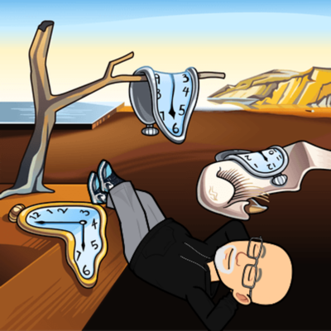
Curriculum design/redesign
Review CCST7e and crossover document.
Review or rewrite objectives.
Consider teaching methods. Do they need to be updated?
How will the student be assessed? How will you know if the student needs additional help? How will you know how well the student has met the objectives?

Slide 5
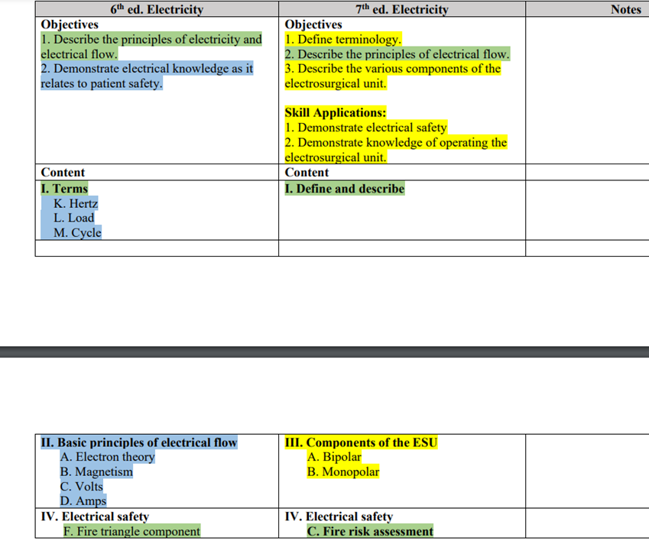
Crossover Document
Available under instructor resources, core curriculum.

Slide 6
Basics of curriculum design - Redesign
Verify institutional outcomes, mission, competencies.
Review program outcomes
Review course objectives.
Consider what is the essential knowledge for the topic.
Create objectives for topic.
Plan assessment(s) for each objective that measures same level.

Slide 7
objectives
What do employers need the student to know?
What are the expectations outlined in the CCST7e?
What level of knowledge is appropriate for each?
A Bloom’s Taxonomy Verb list is a good friend.

Slide 8
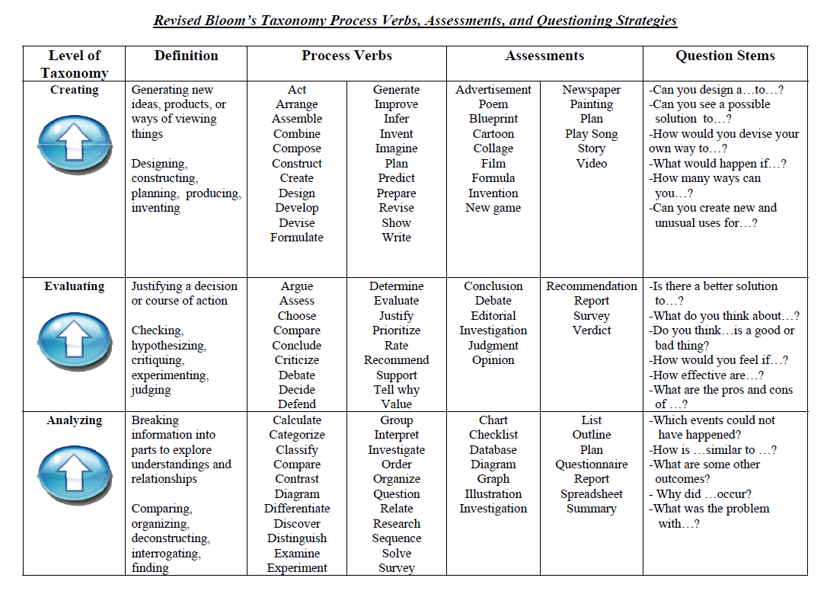

Slide 9
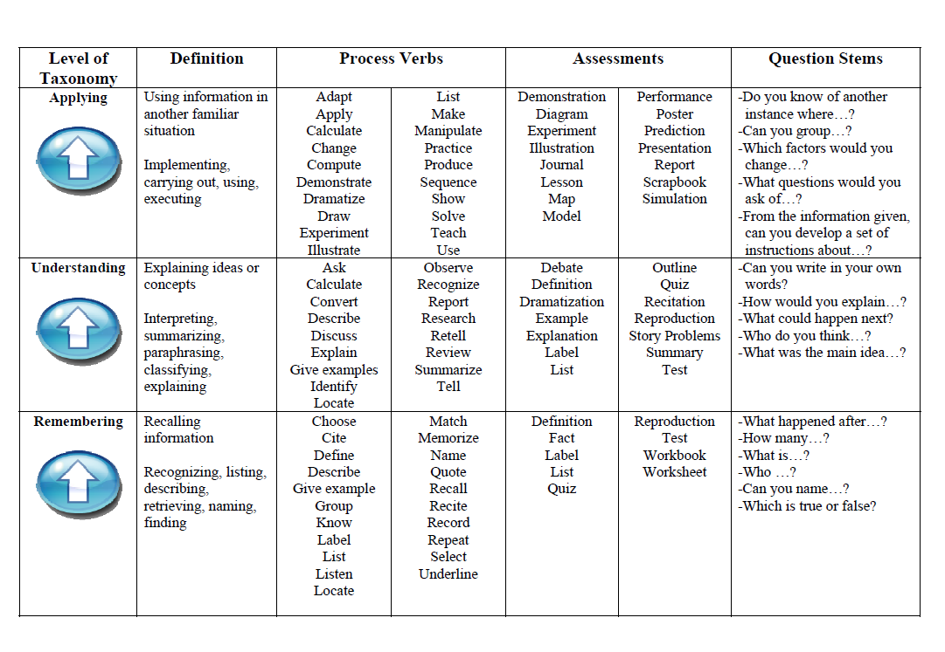

Slide 10
How will it be taught
It takes 536 years to learn everything you need to know about surgery.
It takes 5360 years to teach a student everything they need to know about surgery.

Slide 11
How will it be taught
Are instructional methods current?
How can you increase engagement?
YouTube
Build a circuit
Draw a monopolar and bipolar circuit.
Case Study.

Slide 12
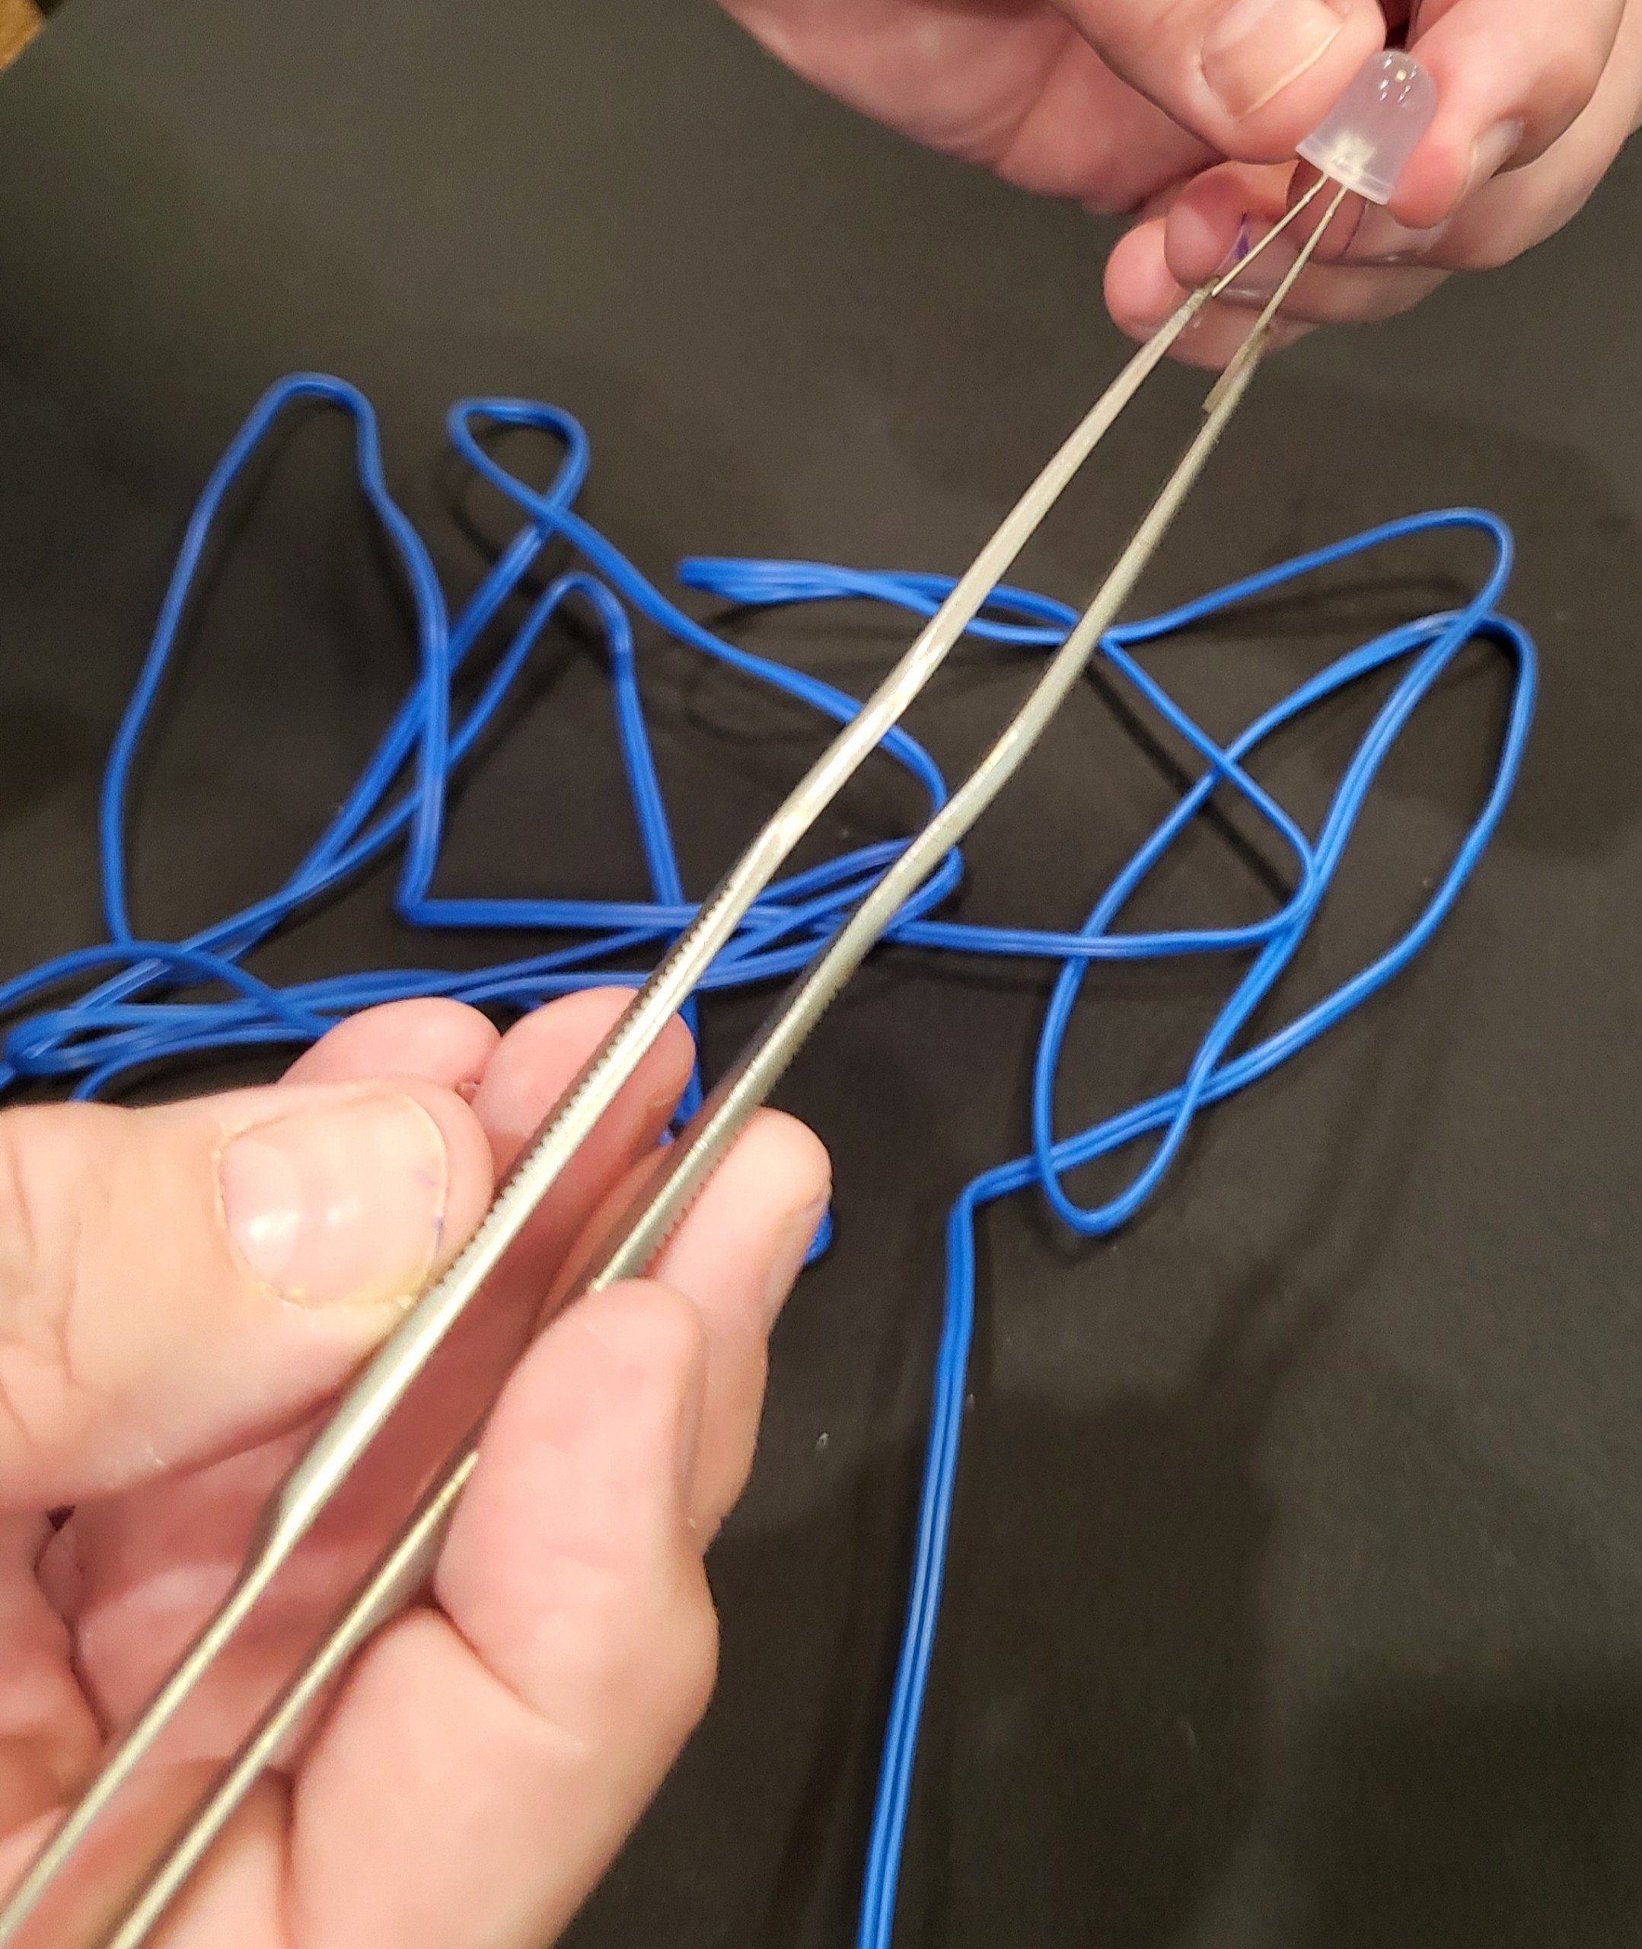
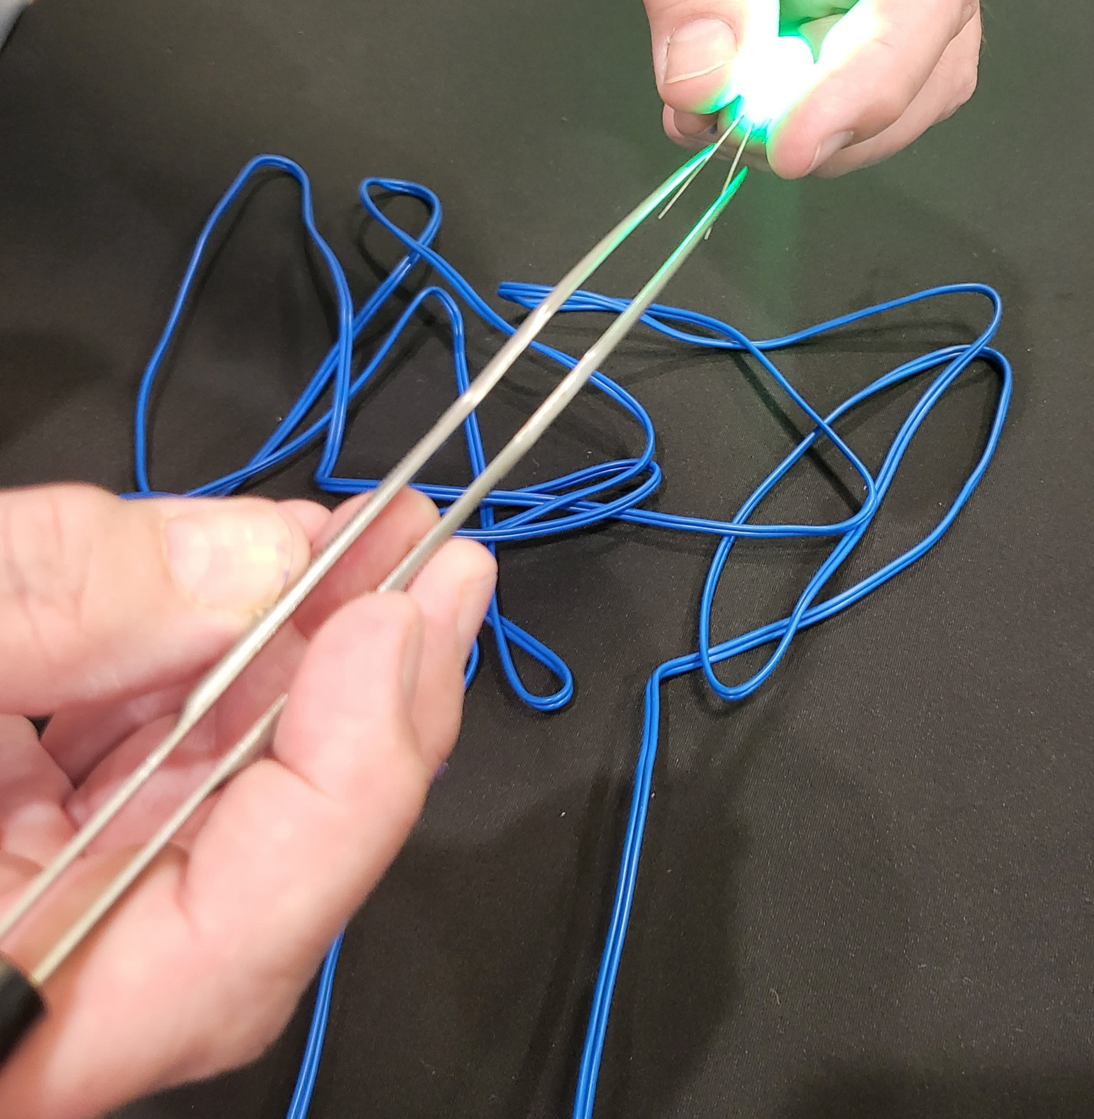

Slide 13
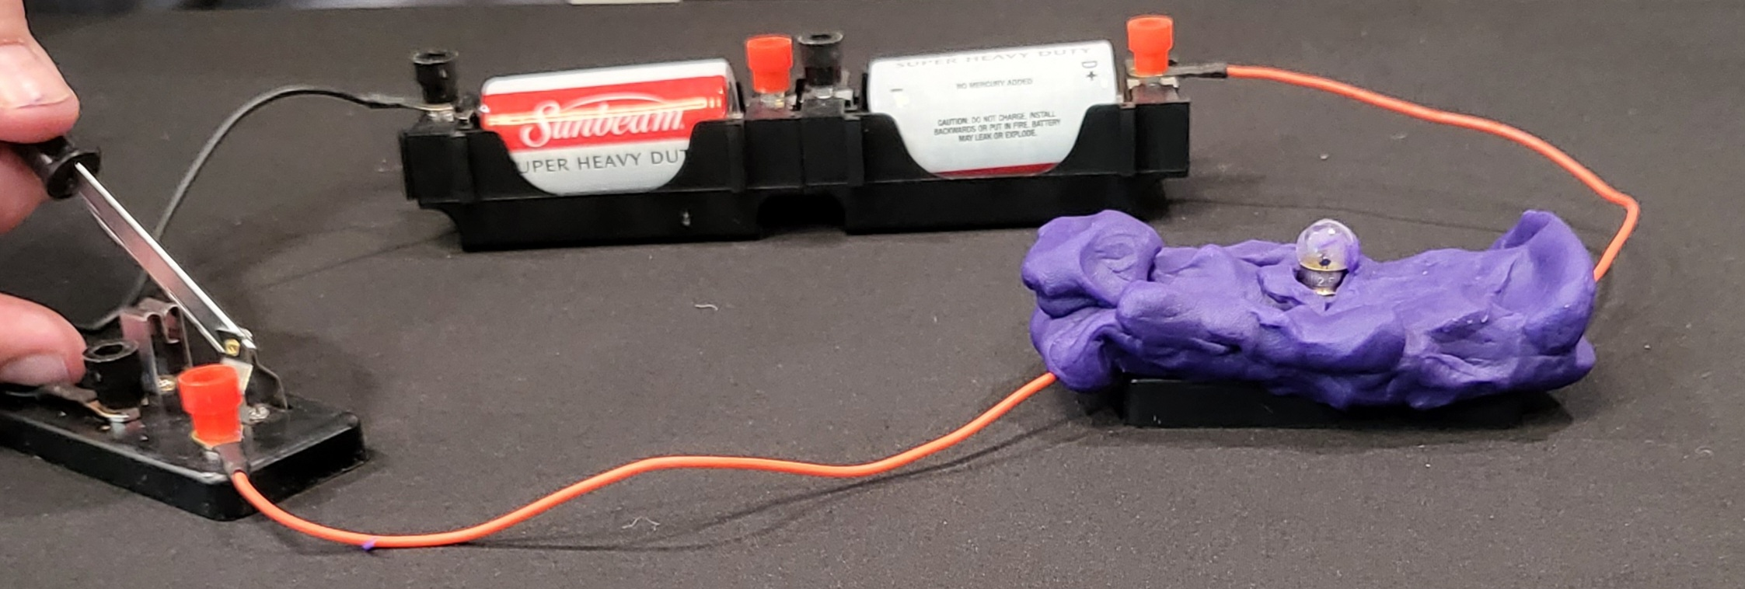
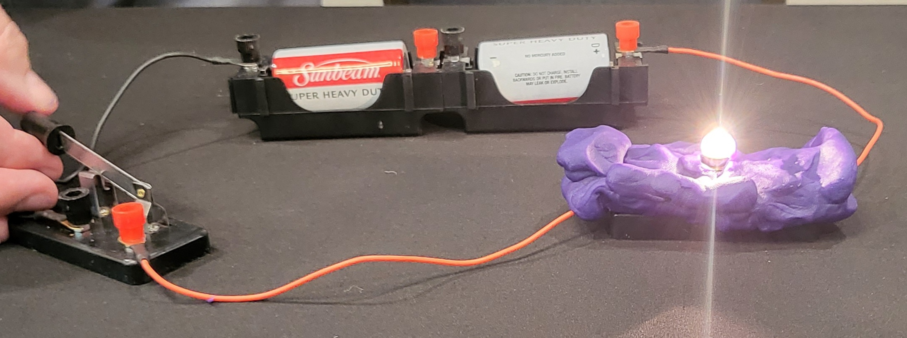

Slide 14
How will it be assessed
What terms does the student need to memorize?
What concepts does the student need to be able to explain?
What skills need to be demonstrated?
Are formative or summative assessments needed?

Slide 15
Curriculum Map - Electrical
Course Module | Program Outcome(s) | Student Learning Competencies | Instructional Methods | Assessments
1 | 3. Apply basic sciences and standards of practice to sterilization, wound healing, asepsis, and patient care. | After completing module one, the student will be able to illustrate the difference between a bipolar circuit and a monopolar cautery circuit | Video Squishy Circuit | After completing module one, the student will draw a monopolar and bipolar cautery circuit. The drawing must include the cautery unit, supplies, and patient. The student should show the flow of current through the patient to return electrode for monopolar and isolated between the tips of bipolar forceps for bipolar.
2

Slide 16
Computer systems
In Surgical Setting
Safe Practices
Patient Confidentiality
And Securing PHI

Slide 17
Computing Systems
I. Computer systems
A. In the surgical setting
1. Basic computer components
2. Computer applications and document processing
3. Computer hardware
B. Hospital digital scheduling boards
C. EMR systems
II. Safe practice
A. Bar code systems
B. Counts and retained foreign bodies
C. Digital documentation
D. Instrument tracking
E. Medication tracking
F. Patient identification
G. Patient Transportation
H. Verification
III. Patient confidentiality and securing PHI
A. Access relevant patient information
B. Keep login information secure
C. Log out of terminals after use
D. Remove patient identifiers from scheduling boards

Slide 18
Information Technology - Objectives
Objectives: The learner will:
1. Describe the basic components of a computer system.
2. Evaluate basic electronic medical records (EMR) systems used.
3. Evaluate safe practices for implementing information technology.
4. Describe best practices in securing protected health information (PHI).
What is essential knowledge?
How will it be assessed?
How will it be taught?

Slide 19
Lasers
I. Biophysics
II. Advantages
III. Systems
A. Argon
B. CO2
C. Diode
D. Krypton
E. Tunable dye
F. Yttrium-aluminum Garnet (YAG)
1. Erbium
2. Holmium
3. Neodymium (Nd) a) KTP
IV. Safety for the surgical team and patient
A. Fire
B. Laser safety checklist
C. Plume
D. Protection

Slide 20
Lasers - Objectives:
Didactic:
1. Describe the biophysics of lasers.
2. Discuss the advantages of using lasers.
3. Describe the types of lasers.
4. Describe the specific applications of each type of laser.
Skill Applications:
1. Demonstrate proper care and handling of surgical lasers.
2. Demonstrate patient and healthcare provider safety in relationship to lasers in a surgical setting.
How will it be taught?
How will it be assessed?
What is essential knowledge?

Slide 21
Think Pair Share

Slide 22
New Combined Minimally invasive applications
7th ed. Minimally Invasive Applications
6th ed. “Endoscopes” is in
“Equipment” and “Robotics” is a separate document.
7th ed.
“Endoscopy” and “Robotics” are in the new document “Minimally Invasive Applications.”

Slide 23
MIS
I. MIS systems
A. Endoscopy
1. Applications
2. Advantages
3. Risks
B. Robotics.
1. Overview
a) Terminology
b) Accessories and emerging technology
1) Firefly®
c) Components
d) Docking
e) Draping
f) Troubleshooting
2. Applications
3. Advantages
4. Risks
Navigation*
1. Components
a) Computer tomography (CT)
b) Magnetic resonance imaging (MRI)
c) O-arm
d) Ultrasound
2. Applications
a) Fiducial markers
3. Advantages
4. Risks

Slide 24
MIS Objective
Objectives: The learner will:
1. Discuss the applications of each type of MIS system.
2. Discuss the advantages of each type of MIS system.
3. Discuss the risks associated with the use of each type of MIS system.
4. Discuss the components of MIS systems.
What is essential knowledge?
How will it be assessed?
How will it be taught?

Slide 25
Interventional Radiology Applications
NOTE: New document in 7th ed.
Objectives: The learner will:
1. Describe the purpose of interventional radiology (IR).
2. Discuss the considerations for the use of IR.
3. Describe imaging modalities.
4. Evaluate the role of the surgical technologist.

Slide 26
Invasive Radiology
I. Concepts
A. Purpose
1. Diagnostic
2. Therapeutic
B. Patient preparation
II. Considerations
A. Anatomical access
B. Patient complications
C. Environment
1. IR suite
2. Standard OR
D. Radiation safety
1. Patient
2. Surgical team
E. Item selection and use (See Supplies)
1. Catheters
2. Contrast media
3. Guidewires
III. Imaging modalities
A. Computer tomography (CT)
B. Digital fluoroscopy
C. Magnetic resonance imaging (MRI)
D. Nuclear medicine
E. Sonography
IV. Role of the surgical technologist

Slide 27
Invasive Radiology
Objectives: The learner will:
1. Describe the purpose of interventional radiology (IR).
2. Discuss the considerations for the use of IR.
3. Describe imaging modalities.
4. Evaluate the role of the surgical technologist
What is essential knowledge?
How will it be taught?
How will it be assessed?

Slide 28
Muddiest Point
Write down one thing you learned.
Write one thing that is not clear.

Slide 29
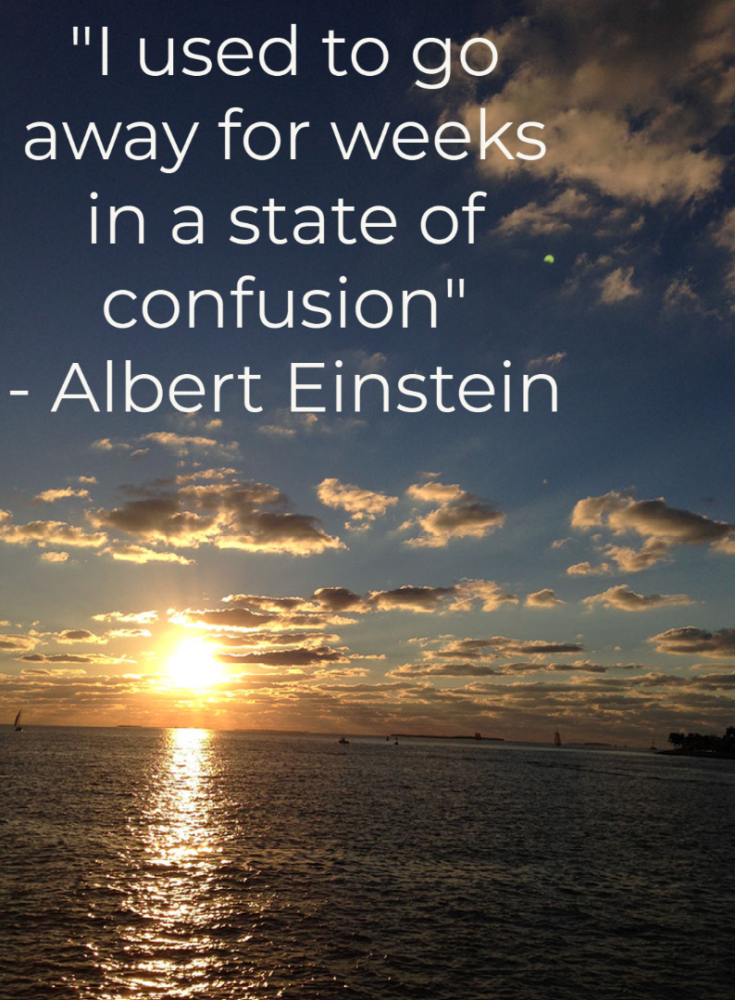
Carla.crayton@calhoun.edu
Grant.Wilson@calhoun.edu

Slide 30
